Slide 1

Music & Movie Group
Anthony Gruber, Avery Peiffer, Samir Sherlaker, Carter Smith
Notes:
We are the music & movie group

Slide 2
Problem Statement
CrossFilmz is still a cross-platform movie recommendation website.
Same as Sprint 0
In other words...
Notes:
Our problem statement is the same as it was in Sprint 0
As a reminder, CrossFilmz is a cross-platform movie recommendation website.
You’ll find results from Netflix, Amazon, Hulu, and Disney+ in the same search.

Slide 3
Key Functionalities
User login page User account registration page Search bar for finding movies Display Movies as a Responsive Grid User profile containing previous ratings | Generate list of recommendations Filter based on streaming service Filter based on genre or other attribute ‘More info’ link when clicking on each movie Ability to add a movie rating out of five stars
Notes:
These are our functional requirements from Sprint 0, some of which have changed
What changed:
No more search bar
We don’t need one! Predefined searches are on the left side of the screen to easily filter results
“More Info” moved to just display on the Movie Button
Rather than cluttering the screen with info that’s irrelevant to the user, we put all the necessary info in the Movie Buttons

Slide 4


Tech Stack
Client: ReactJS
Server: Flask
SQL Database with Python
Notes:
We’ve had slight changes on the tech stack too
Google cloud was giving us trouble because the NodeJS project configuration required an App Engine Flex environment, which requires payment
Because of this, we used SQL for our database, and we’re not concerning ourselves with deploying the app

Slide 5
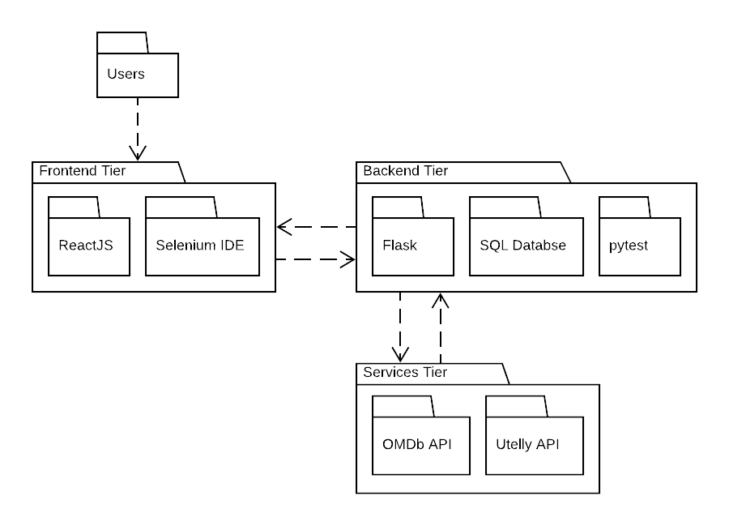


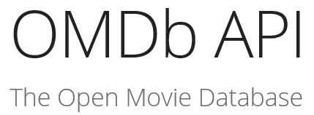

Multi-Tiered Architecture Diagram
Unit Testing
The APIs are “singletons” since we query one service
Notes:
Here’s an architectural diagram of our project using the Multi-tiered architectural pattern
The frontend and backend of our code are run on the same machine, but the APIs are not
Also, for some of our Tech Info, we’re using Selenium IDE and pytest for unit testing (Se is frontend, pytest is backend).
The APIs are singletons in the sense that we send our requests to those same, individual APIs

Slide 6
Measuring Quality
The best ways to measure CrossFilmz are as follows:
Relevance of stratified results
Speed of algorithm (page load)
Given our problem statement, being able to filter your results by platform is the most important factor of the site, second to speed.
Notes:
These are the ways we’d recommend to measure the quality of CrossFilmz because they best reflect what CrossFilmz was designed to do well at.
Have results from mixed platforms and be able to filter amongst them
Get your results in a reasonable amount of time

Slide 7
Demo Time
Notes:
Now the demo...

Slide 8
Image Citations
https://en.wikipedia.org/wiki/React_(JavaScript_library)
https://en.wikipedia.org/wiki/Flask_(programming)
https://docs.pytest.org/en/latest/
https://chrome.google.com/webstore/detail/selenium-ide/mooikfkahbdckldjjndioackbalphokd
https://www.omdbapi.com/
https://rapidapi.com/utelly/api/utelly

